Slide 1
Case Study: Additional Cases for Linear (and Integer) Programming
Using mathematical tools to explore real-world problems.

Slide 2
Workforce Assignment
Workforce assignment
National Wing Company (NWC) is gearing up for
the new B-48 contract. NWC has agreed to produce 20
wings in April, 24 in May, and 30 in June.
Currently, NWC has 100 fully qualified workers. A fully qualified worker can either be placed in production or can train new recruits. A new recruit can be trained to be an apprentice in one month. After another month, the apprentice becomes a qualified worker. Each trainer can train two recruits.

Slide 3

Workforce Assignment
The production rate and salary per employee
type is listed below.
Type of Production Rate Wage
Employee (Wings/Month) Per Month
Production .6 $3,000
Trainer .3 $3,300
Apprentice .4 $2,600
Recruit .05 $2,200
At the end of June, NWC wishes to have no recruits
or apprentices, but have at least 140 full-time workers.

Slide 4
Workforce Assignment
Define the Decision Variables
P_{i} = number of producers in month i
(where i = 1, 2, 3 for April, May, June)
T_{i} = number of trainers in month i
(where i = 1, 2 for April, May)
A_{i} = number of apprentices in month i
(where i = 2, 3 for May, June)
R_{i} = number of recruits in month i
(where i = 1, 2 for April, May)

Slide 5
Workforce Assignment
Define the Objective Function
Minimize total wage cost for producers, trainers, apprentices, and recruits for April, May, and June:
Min 3000P₁ + 3300T₁ + 2200R₁ + 3000P₂ + 3300T₂
+ 2600A₂+2200R₂ + 3000P₃ + 2600A₃

Slide 6
Workforce Assignment
Define the Constraints
Total production in Month 1 (April) must equal or
exceed contract for Month 1:
(1) .6P₁ + .3T₁ +.05R₁ > 20
Total production in Months 1-2 (April, May) must
equal or exceed total contracts for Months 1-2:
(2) .6P₁ + .3T₁ + .05R₁ + .6P₂ + .3T₂ + .4A₂ + .05R₂ > 44
Total production in Months 1-3 (April, May, June)
must equal or exceed total contracts for Months 1-3:
.6P₁+.3T₁+.05R₁+.6P₂+.3T₂+.4A₂+.05R₂
+.6P₃+.4A₃ > 74

Slide 7
Workforce Assignment
Define the Constraints (continued)
The number of producers and trainers in a month
must equal the number of producers, trainers, and
apprentices in the previous month:
(4) P₁ - P₂ + T₁ - T₂ = 0
(5) P₂ - P₃ + T₂ + A₂ = 0
The number of apprentices in a month must equal
the number of recruits in the previous month:
(6) A₂ - R₁ = 0
(7) A₃ - R₂ = 0

Slide 8
Workforce Assignment
Define the Constraints (continued)
Each trainer can train two recruits:
(8) 2T₁ - R₁ > 0
(9) 2T₂ - R₂ > 0
In April there are 100 employees that can be producers or trainers:
(10) P₁ + T₁ = 100
At the end of June, there are to be at least 140 employees:
(11) P₃ + A₃ > 140
Non-negativity:
P₁, T₁, R₁, P₂, T₂, A₂, R₂, P₃, A₃ > 0

Slide 9

Workforce Assignment
Solution Summary
P₁ = 100, T₁ = 0, R₁ = 0
P₂ = 80, T₂ = 20, A₂ = 0, R₂ = 40
P₃ = 100, A₃ = 40
Total Wage Cost = $1,098,000
April May June July
Producers
Trainers
Apprentices
Recruits
100 80 100 140
0 20 0 0
0 0 40 0
0 40 0 0

Slide 10
Modeling Flexibility Provided by 0-1 Variables
When x_{i} and x_{j} represent binary variables designating whether projects i and j have been completed, the following special constraints may be formulated:
  At most k out of n projects will be completed:
Σx_{j} < k
j
  Project j is conditional on project i:
  x_{j} - x_{i} < 0
  Project i is a corequisite for project j:
  x_{j} - x_{i} = 0
  Projects i and j are mutually exclusive:
  x_{i} + x_{j} < 1

Slide 11
Example: Metropolitan Microwaves
Metropolitan Microwaves, Inc. is planning to expand its sales operation by offering other electronic appliances. The company has identified seven new product lines it can carry. Relevant information about each line follows on the next slide.

Slide 12
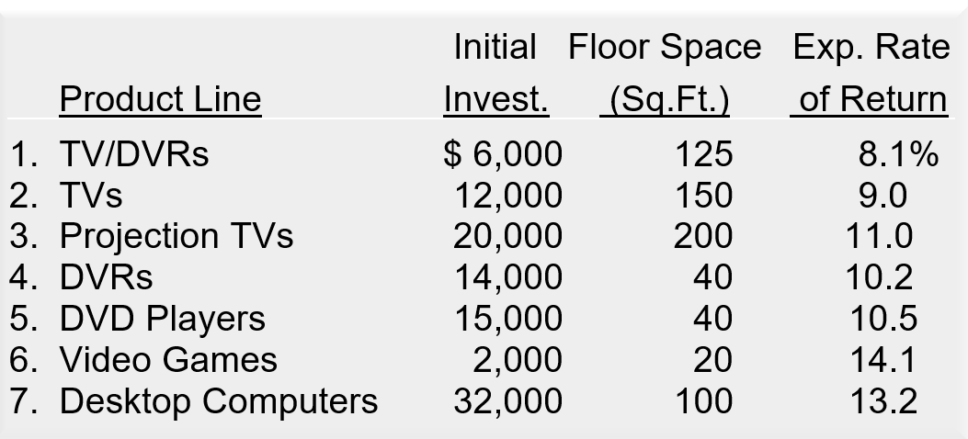
Example: Metropolitan Microwaves

Slide 13
Example: Metropolitan Microwaves
Metropolitan has decided that they should not stock projection TVs unless they stock either TV/DVRs or TVs. Also, they will not stock both DVRs and DVD players, and they will stock video games if they stock TVs. Finally, the company wishes to introduce at least three new product lines.
If the company has $45,000 to invest and 420 sq. ft. of floor space available, formulate an integer linear program for Metropolitan to maximize its overall expected return.

Slide 14
Define the Decision Variables
x_{j} = 1 if product line j is introduced;
= 0 otherwise.
where:
Product line 1 = TV/DVRs
Product line 2 = TVs
Product line 3 = Projection TVs
Product line 4 = DVRs
Product line 5 = DVD Players
Product line 6 = Video Games
Product line 7 = Desktop Computers

Slide 15
Example: Metropolitan Microwaves
Define the Decision Variables
x_{j} = 1 if product line j is introduced;
= 0 otherwise.
Define the Objective Function
Maximize total expected return:
Max .081(6000)x₁ + .09(12000)x₂ + .11(20000)x₃
+ .102(14000)x₄ + .105(15000)x₅
+ .141(2000)x₆ + .132(32000)x₇

Slide 16
Define the Constraints
1) Money:
6x₁ + 12x₂ + 20x₃ + 14x₄ + 15x₅ + 2x₆ + 32x₇ < 45
2) Space:
125x₁ +150x₂ +200x₃ +40x₄ +40x₅ +20x₆ +100x₇ < 420
3) Stock projection TVs only if stock TV/DVRs or TVs:
x₁ + x₂ > x₃ or x₁ + x₂ - x₃ > 0

Slide 17
Define the Constraints (continued)
4) Do not stock both DVRs and DVD players:
x₄ + x₅ < 1
5) Stock video games if they stock TV's:
x₂ - x₆ > 0
6) Introduce at least 3 new lines:
x₁ + x₂ + x₃ + x₄ + x₅ + x₆ + x₇ > 3
7) Variables are 0 or 1:
x_{j} = 0 or 1 for j = 1, , , 7

Slide 18

Optimal Solution
Introduce:
TV/DVRs, Projection TVs, DVD Players
Do Not Introduce:
TVs, DVRs, Video Games, Desktop Computers
Total Expected Return:
$4,261

Slide 19
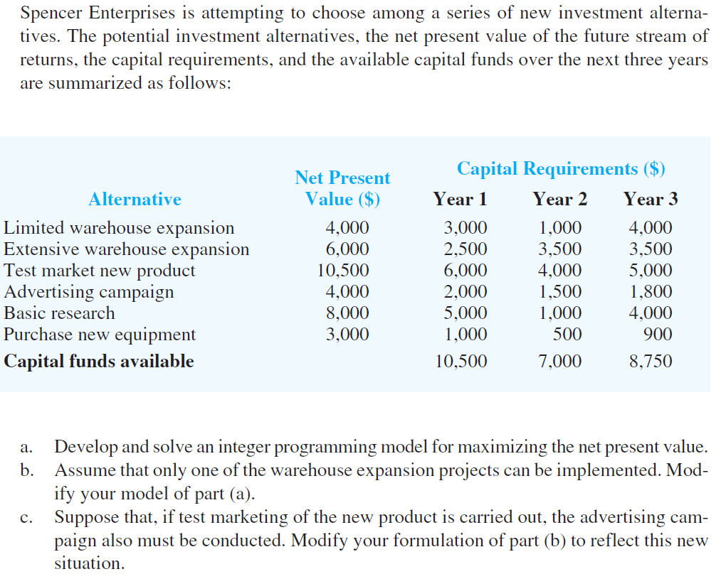
Exercise

Slide 20
Cautionary Note About Sensitivity Analysis
Sensitivity analysis often is more crucial for ILP problems than for LP problems.
A small change in a constraint coefficient can cause a relatively large change in the optimal solution.
Recommendation: Resolve the ILP problem several times with slight variations in the coefficients before choosing the “best” solution for implementation.

Slide 21
Example: All-Integer LP
Optimal All-Integer Solution
x₂
5
- x₁ + x₂ < 1
4
3x₁ + x₂ < 9
Max 3x₁ + 2x₂
3
ILP Optimal (3, 0)
2
x₁ + 3x₂ < 7
1
x₁
1 2 3 4 5 6 7

